Slide 1
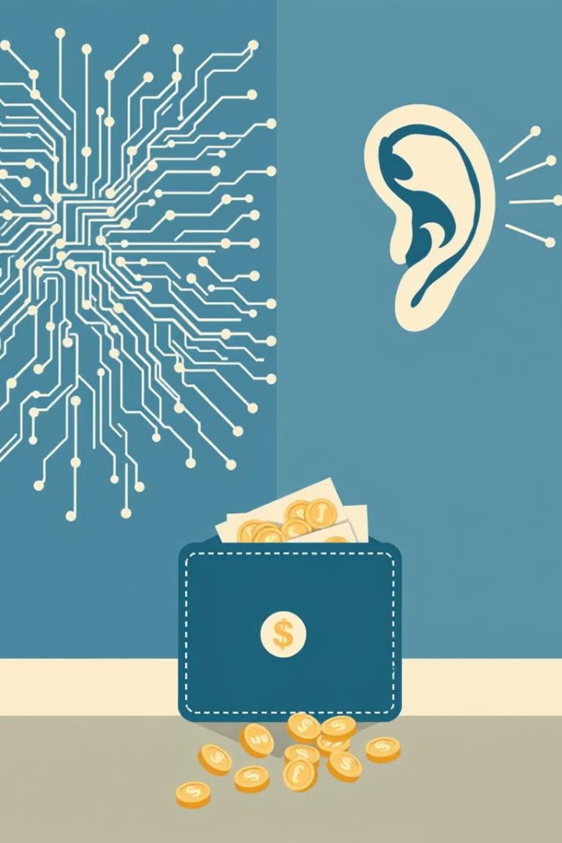

Mini-Project Topics
Bitcoin Price Prediction
Crypto wallet
Human Scream Detection

Slide 2
Bitcoin Price Prediction: Problem Statement
The Challenge
Why It Matters
Bitcoin's price is volatile and unpredictable. Can we use machine learning to forecast its value?
Accurate predictions can benefit investors, traders, and businesses operating in the cryptocurrency space.

Slide 3
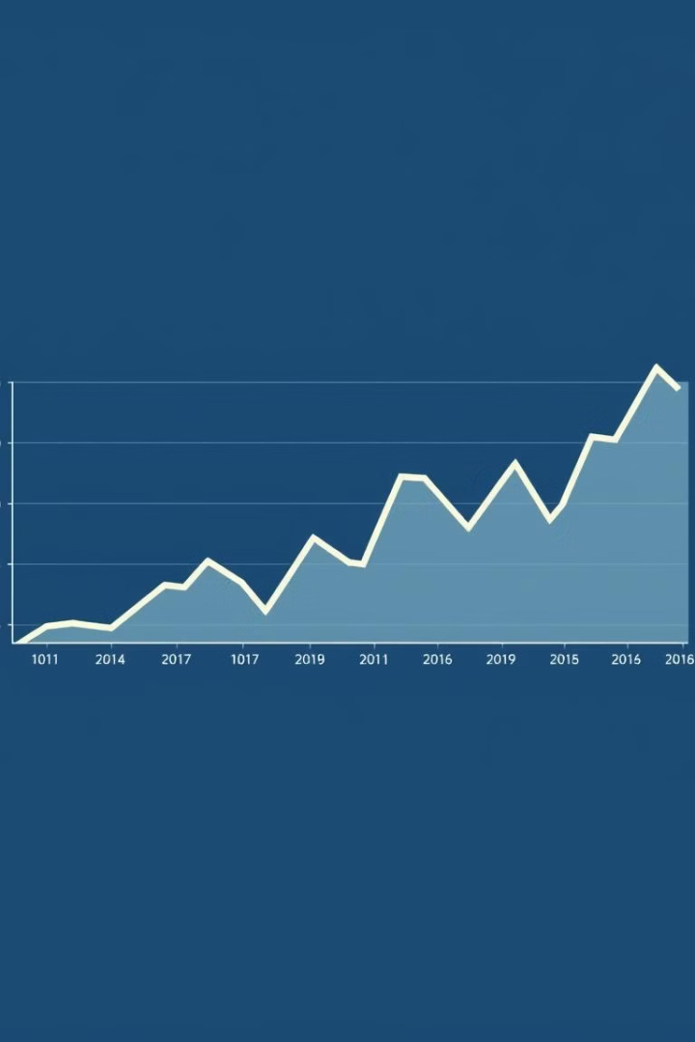
Bitcoin Price Prediction: Visualization
1
Historic Data
Leveraging historical Bitcoin prices and related market data.
2
Machine Learning Models
Training models to identify patterns and predict future price movements.
3
Visual Comparison
Comparing the predicted Bitcoin prices with actual market data to evaluate model accuracy.

Slide 4

Bitcoin Price Prediction: Research Paper Links
Paper 1
Paper 2
https://www.sciencedirect.com/science/article/abs/pii/S1059056024000704
https://www.sciencedirect.com/science/article/abs/pii/S1544612324011656
Paper 3
https://www.sciencedirect.com/science/article/abs/pii/S0952197624010157

Slide 5
Human Scream Detection: Problem Statement
The Challenge
Why It Matters
Develop a system that can accurately detect and differentiate human screams from other sounds.
Applications in security systems, emergency response, and even virtual reality experiences.

Slide 6



Human Scream Detection: Thesis
Sound Signal Acquisition
1
Recording and preprocessing audio data.
Feature Extraction
2
Analyzing audio signals to identify characteristics specific to screams.
Classification
3
Training machine learning models to classify audio signals as screams or non-screams.

Slide 7
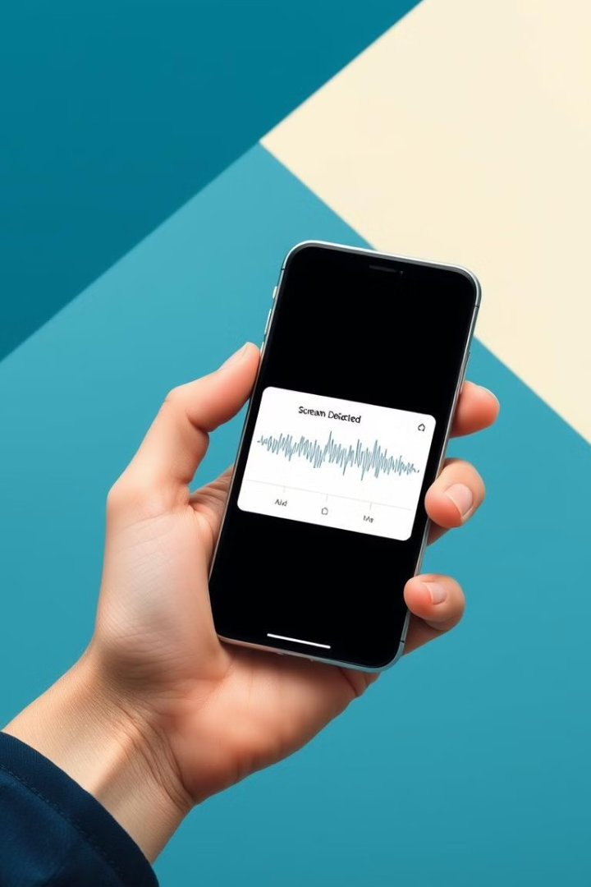



Human Scream Detection: Research Links
Paper 1
Paper 2
https://www.sciencedirect.com/science/article/abs/pii/S0026269223003373
https://www.sciencedirect.com/science/article/abs/pii/S157087052400218X
Paper 3
https://www.sciencedirect.com/science/article/pii/S1544612324000485

Slide 8
Crypto Wallet: Problem Statement
The Challenge
Why It Matters
Design a secure and user-friendly interface for managing and transacting cryptocurrencies.
Crypto wallets play a crucial role in the adoption and accessibility of cryptocurrency.

Slide 9
Crypto Wallet: Transaction Process
Generate Address
1
Create a unique identifier for your wallet.
Receive Funds
2
Receive cryptocurrency into your wallet.
Send Funds
3
Transfer cryptocurrency to another wallet.
Transaction Confirmation
4
Verify and complete the transaction.

Slide 10

Crypto Wallet: Research Links
1
2
Paper 1
Paper 2
https://www.sciencedirect.com/science/article/pii/S0267364923000390
https://www.sciencedirect.com/science/article/pii/S2666281722001585
3
Paper 3
https://www.sciencedirect.com/science/article/pii/S1877050923017362

